Slide 1

Implementation of
Token Ring Protocol
Using LGI
Department of Computer Science
Rutgers, the State University of New Jersey, New Brunswick
CS- 547
Instructor: Professor Naftaly Minsky
Niraj Dholakia (nd387) Saurabh Deochake (srd117) Romina Nayak(rn279)
MS Computer Science MS Computer Science MS Computer Science

Slide 2

CONTENTS
Introduction to Token Ring Protocol
Initial Implementation
Maintaining Liveness and Fairness of the System
Tolerance to Loss of Token
Making the Model Incremental
Demonstration
Tolerance to Loss of a Agent

Slide 3

Introduction
An Agent in our Token Ring System can have one of the following role:
Manager
Server
Ring Member

Slide 4

System Policy
Our Law implements the following policies :
There is a single token in the whole ring
Only the holder of the token is allowed to send messages
The token is passed in a predefined direction (in a ring fashion)
The token can only be held up to a maximum time period

Slide 5

We also assume:
The Manager of the system never fails/dies.
Any agent who adopts the Law becomes its Ring member.
The Manager and Server are predefined in the law and they do not change.

Slide 6
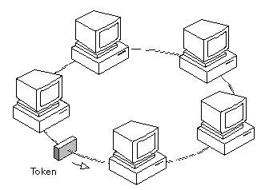
Initial Implementaion
Created a Ring of 3 agents
The “next” field of all the agents get updated when an agent adopts the law
Token introduced in the system by Manager

Slide 7

Keeping System Fair and aLive
The system is made fair by use of Obligation in Law.
Obligation ensures that every Member of the ring releases the token after 10 sec.
This makes the system fair and maintains the liveliness of the system.

Slide 8
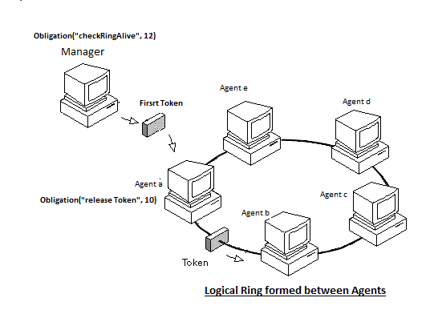
Fault Tolerance: Token Loss

Slide 9
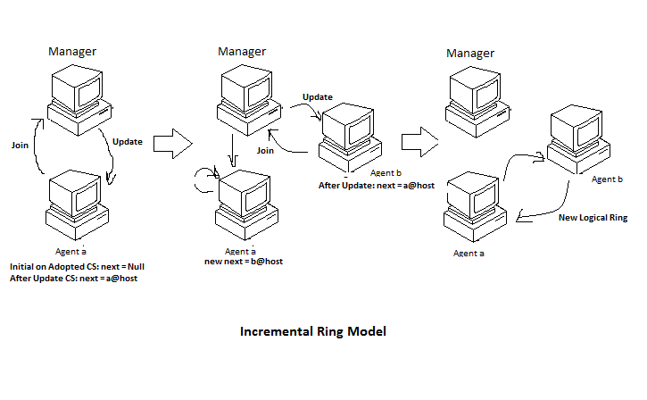
Making the Ring Incremental

Slide 10

Fault Tolerance: Loss of Agent

Slide 11
DEmonstration

Slide 12

Future Work
Make the system more secure using Certificates.
Remove the use of Manager and make the system truly decentralized.
Provide a better graphical Visualization for the System

Slide 13


Slide 14


